Slide 1

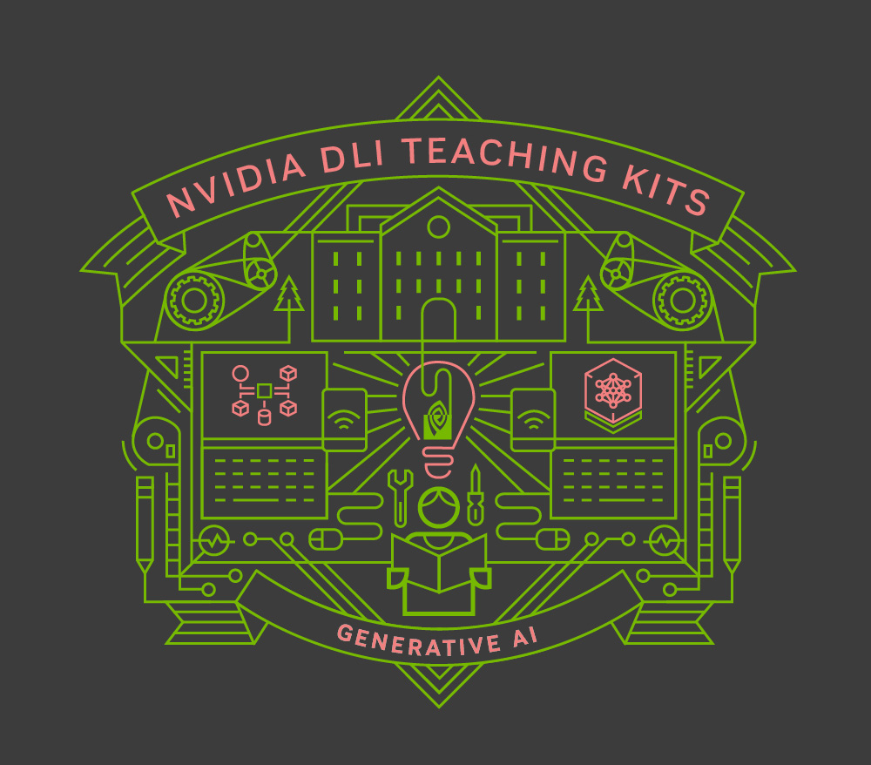
Lecture 6.2 – UNets and Diffusion Models
Generative AI Teaching Kit

Slide 2

The NVIDIA Deep Learning Institute Generative AI Teaching Kit is licensed by NVIDIA and Dartmouth College under the
Creative Commons Attribution-NonCommercial 4.0 International License.

Slide 3
This lecture
Recap of issues with GANs
UNet and Autoencoders
Denoising Images
Diffusion Models
Pros and cons of diffusion models
Potential improvements

Slide 4
Recap on GANs and Image GenAI

Slide 5
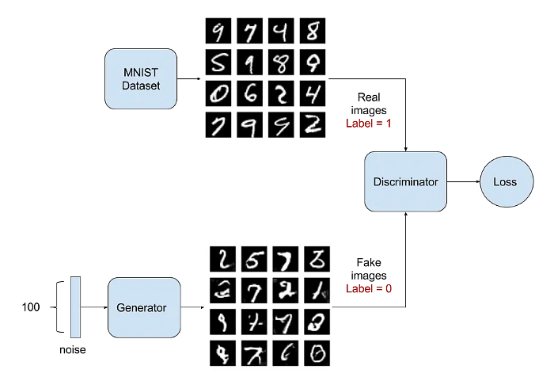
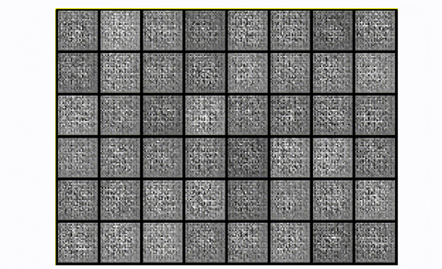
GAN Recap
Last time, we looked at how GANs can be used to generate new data
Notes:
https://www.projectpro.io/article/generative-adversarial-networks-gan-based-projects-to-work-on/530

Slide 6
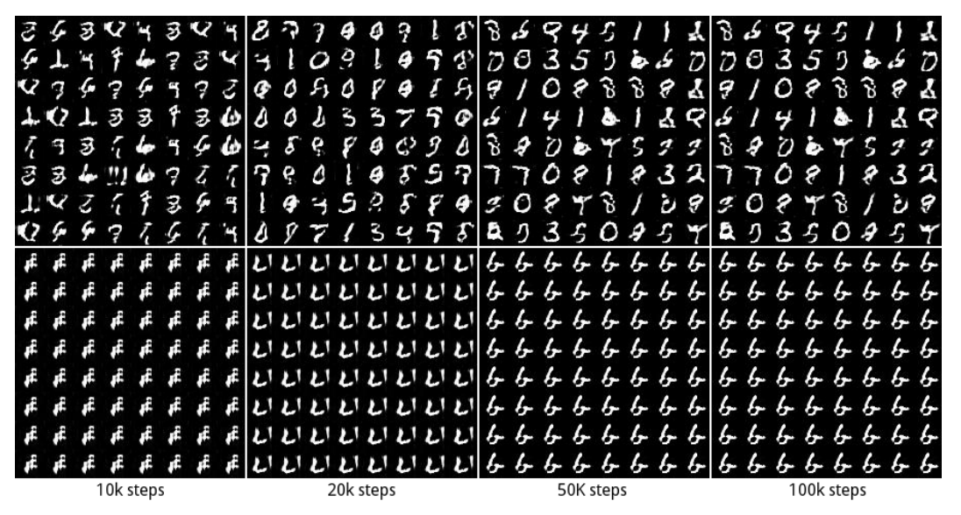
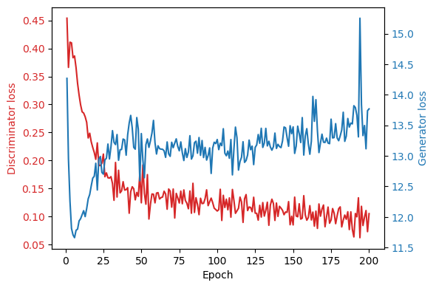
GAN Problems – Mode Collapse and Instability
During training a Generator can find a local minima which produces strong feedback from the discriminator. This is known as Mode Collapse.
Another challenge of GAN training is instability
If the Discriminator is too strong, then the Generator struggles to train.

Slide 7
UNet Architecture

Slide 8
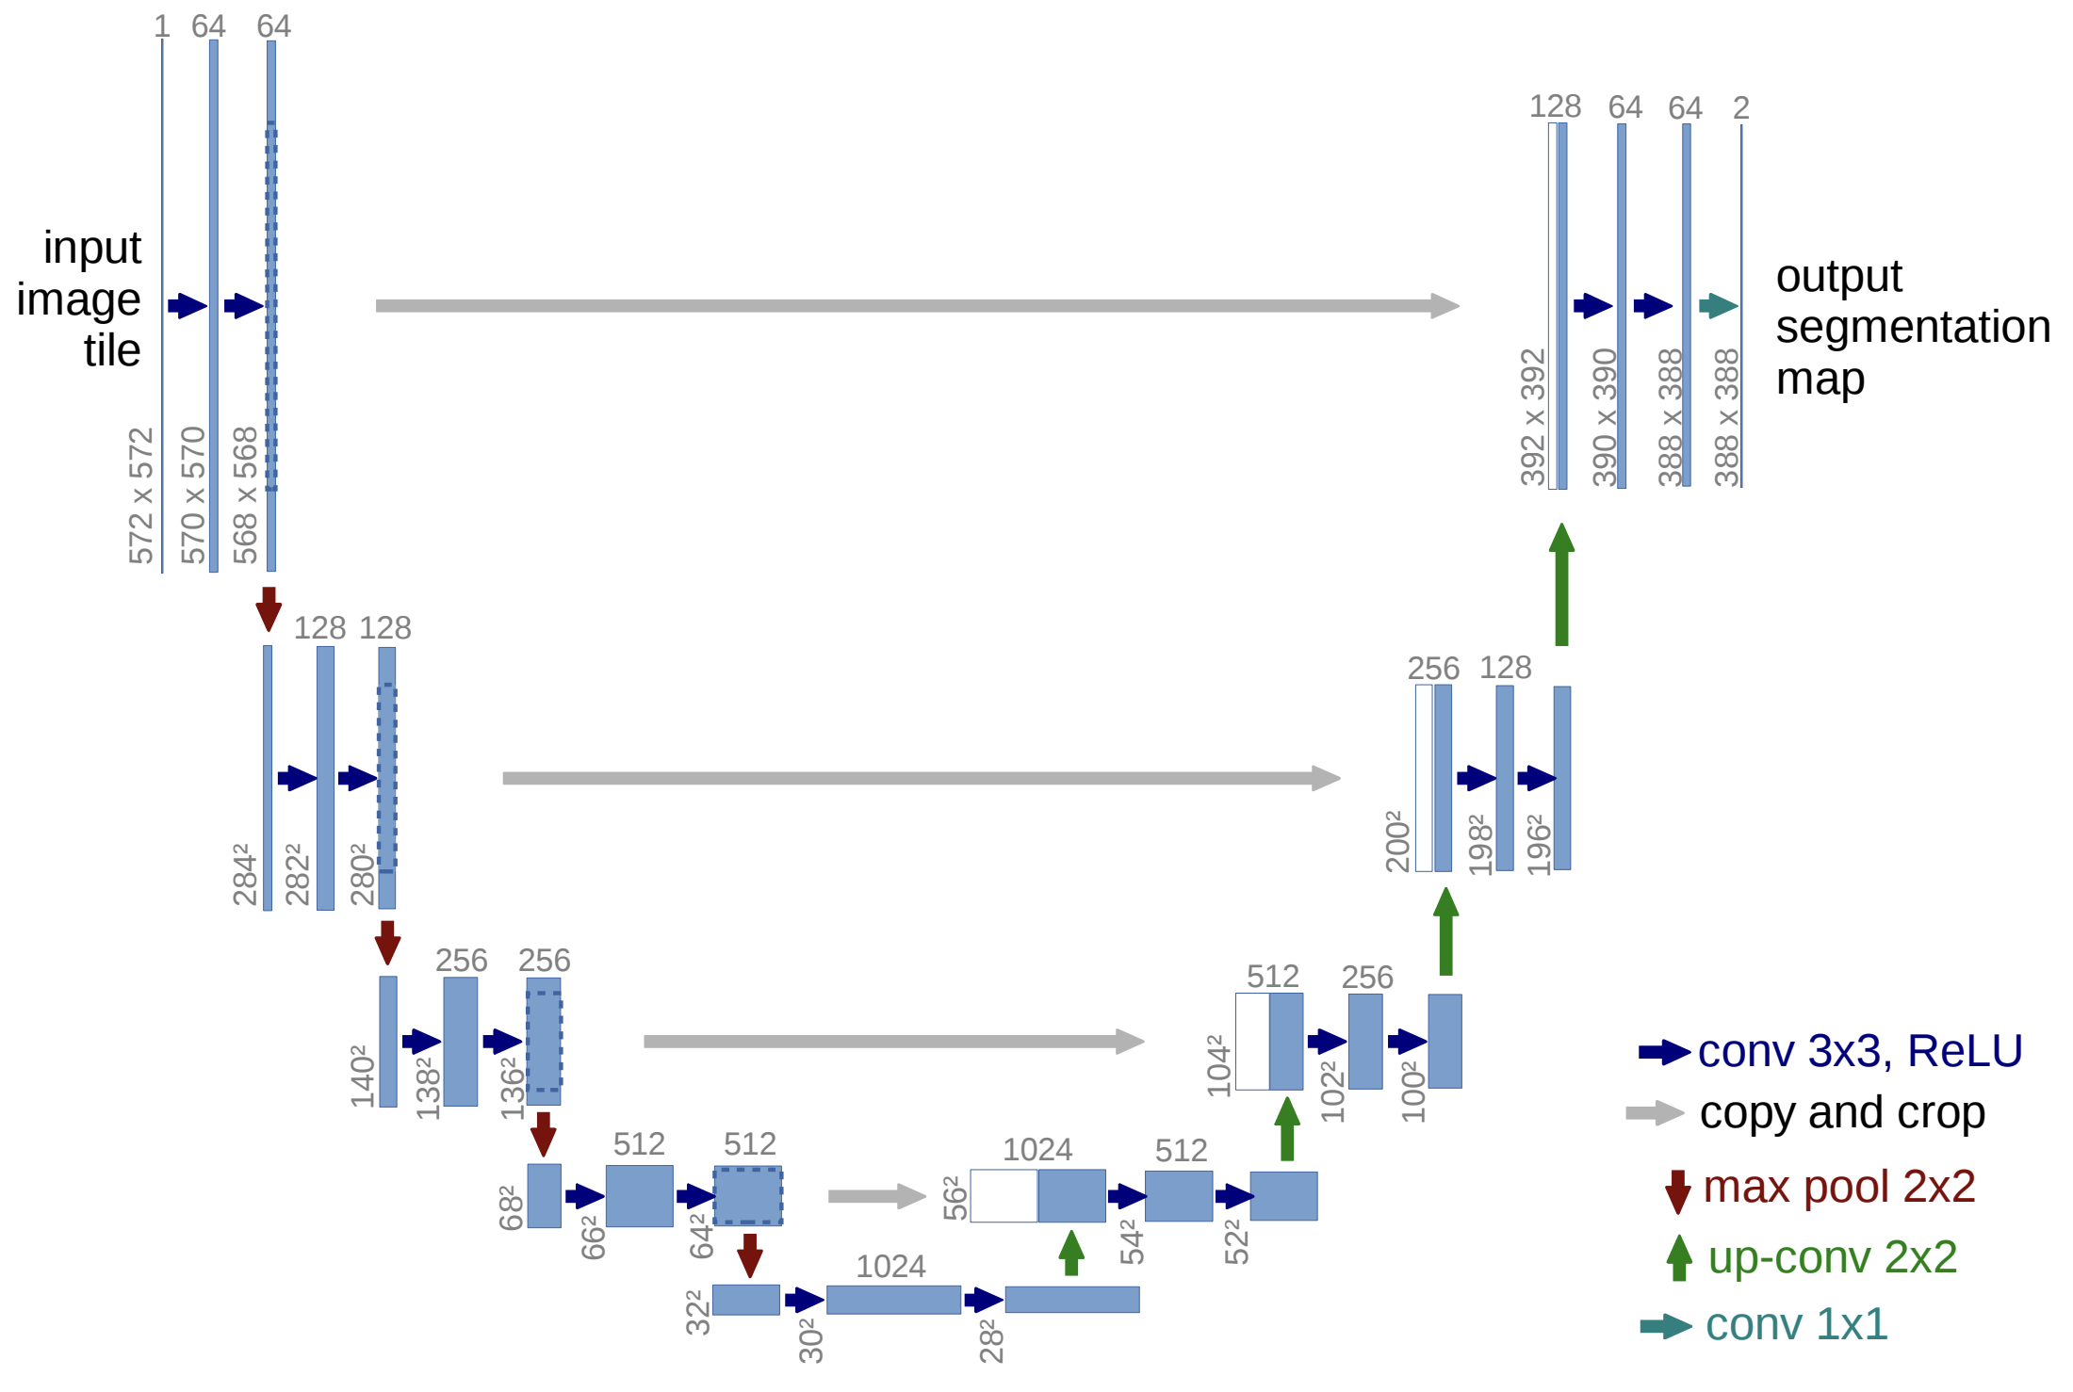
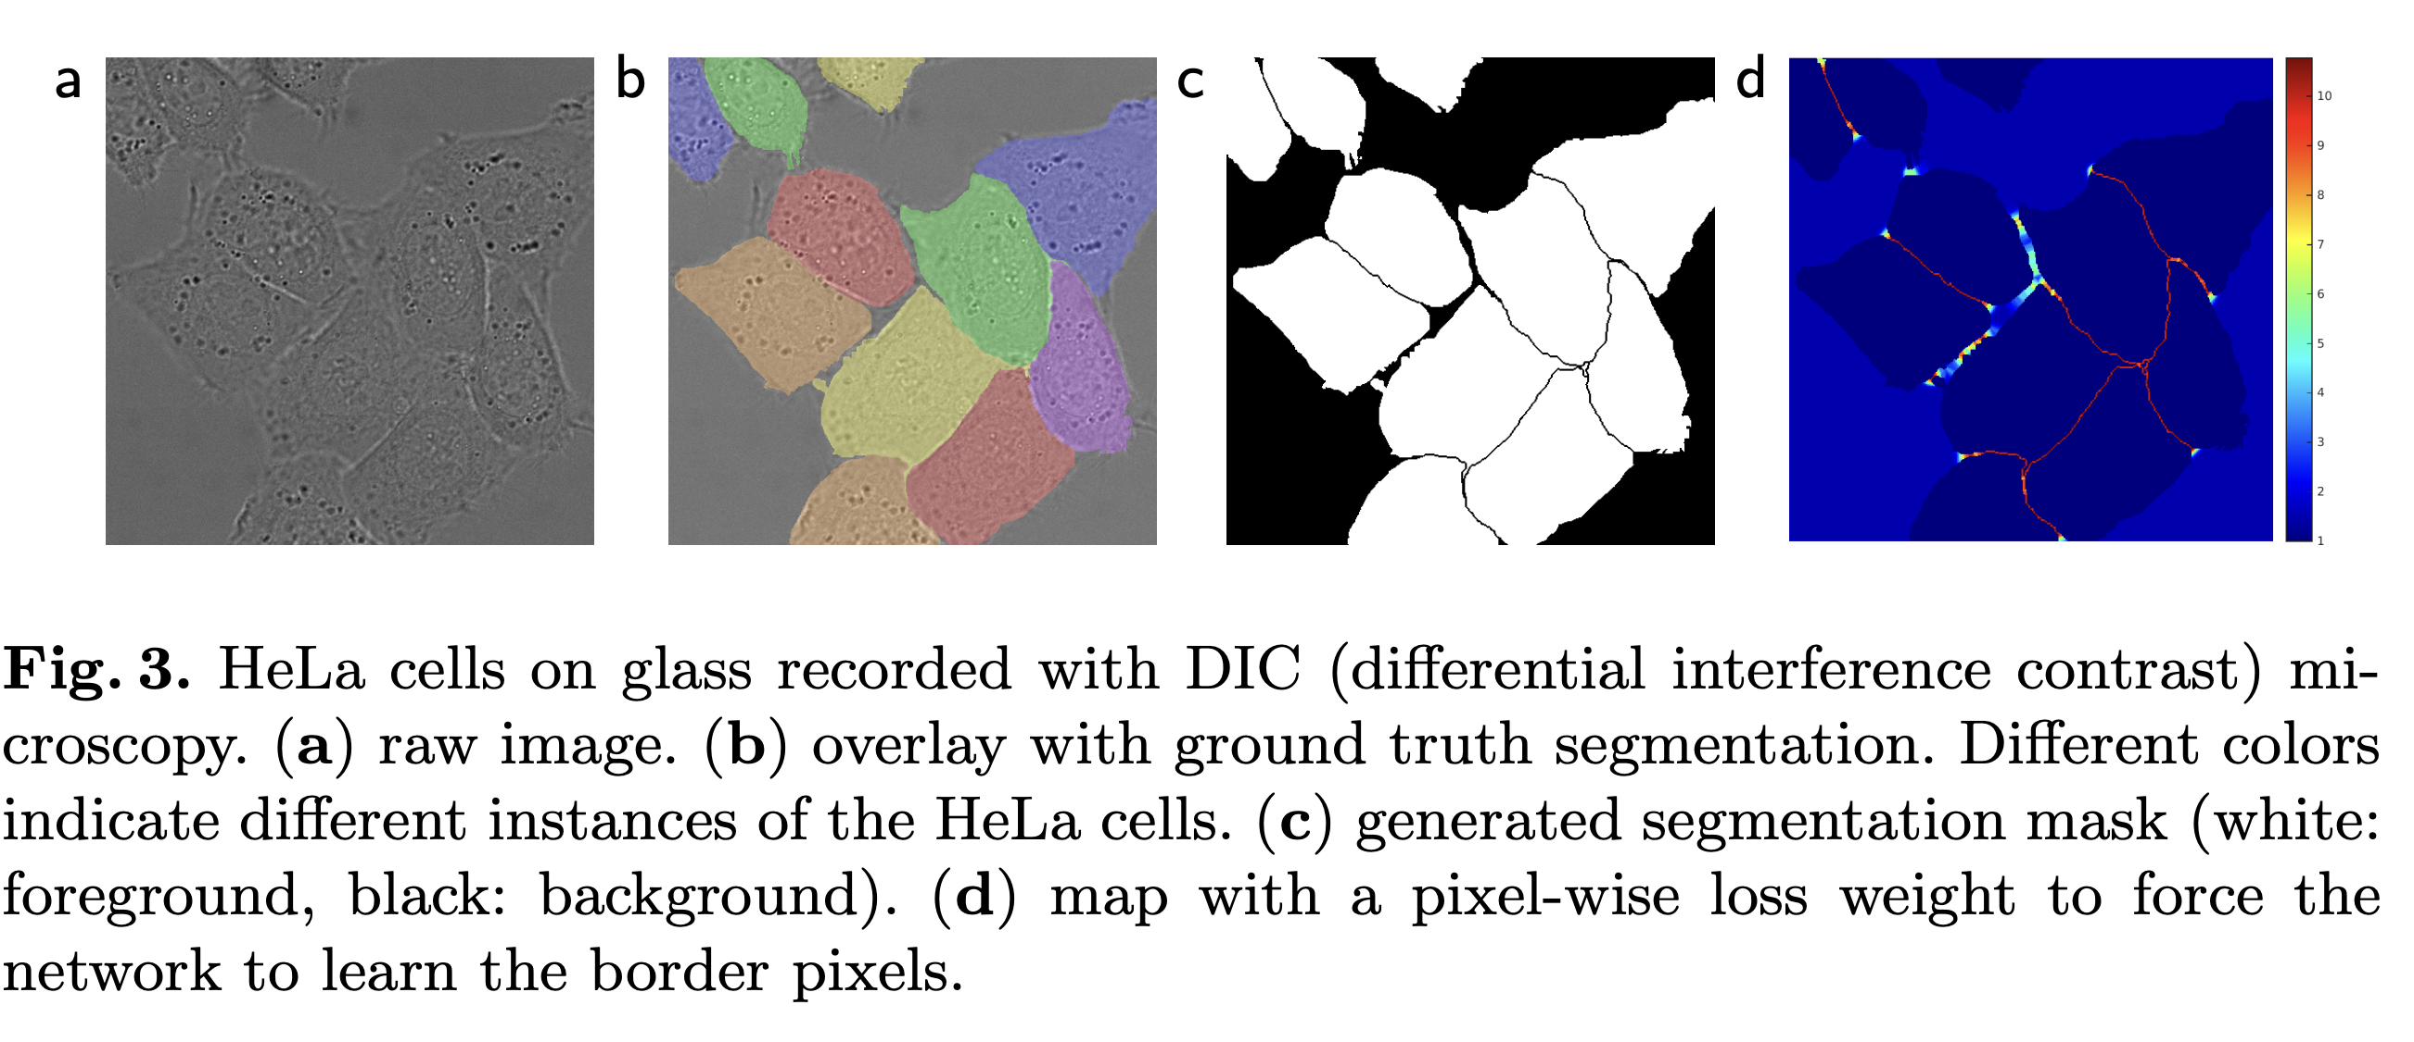
UNet - A New Architecture for Image Models
The UNet architecture was introduced in 2015 by Ronneberger et.al for Biomedical Image Segmentation
Prior to UNet, many segmentation methods required large amounts of training data and were not well-suited for tasks with limited annotated datasets, which is common in medical imaging.
Existing methods often failed to provide high-resolution segmentation maps and struggled with capturing fine details
Notes:
https://arxiv.org/pdf/1505.04597

Slide 9
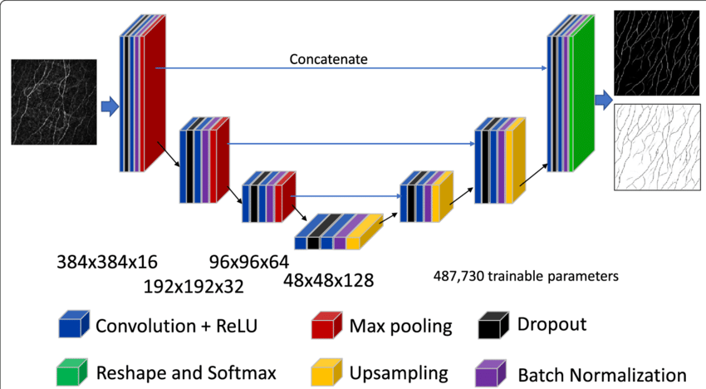
UNet - Features and Utility
The U-Net is a novel encoder-decoder architecture.
The encoder captures context by down-sampling the input image
The decoder enables precise localization by up-sampling.
Skip connections are used to directly transfer high-resolution features from the encoder to the corresponding layers in the decoder
It has been widely adopted and extended for various applications, including medical image analysis, satellite image segmentation, denoising, and more.
Notes:
https://eandv.biomedcentral.com/articles/10.1186/s40662-020-00192-5

Slide 10
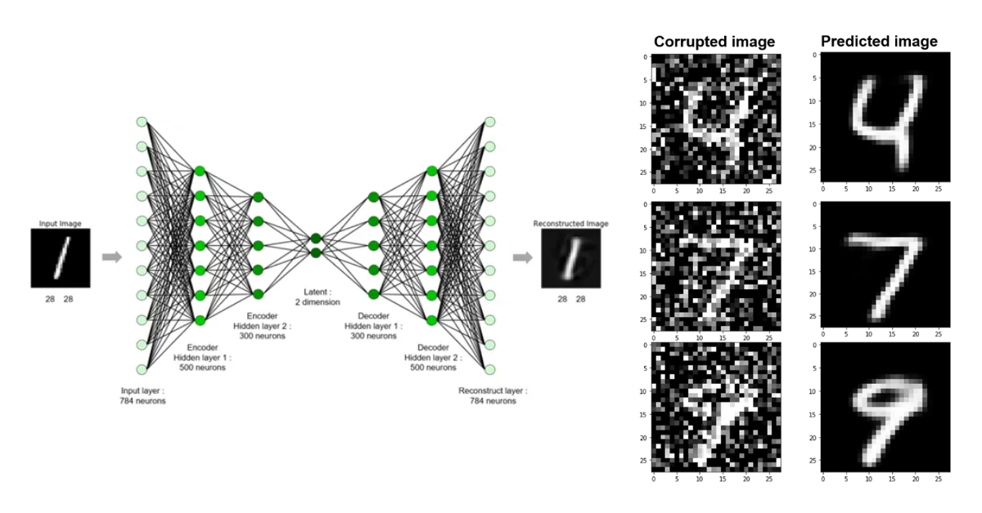
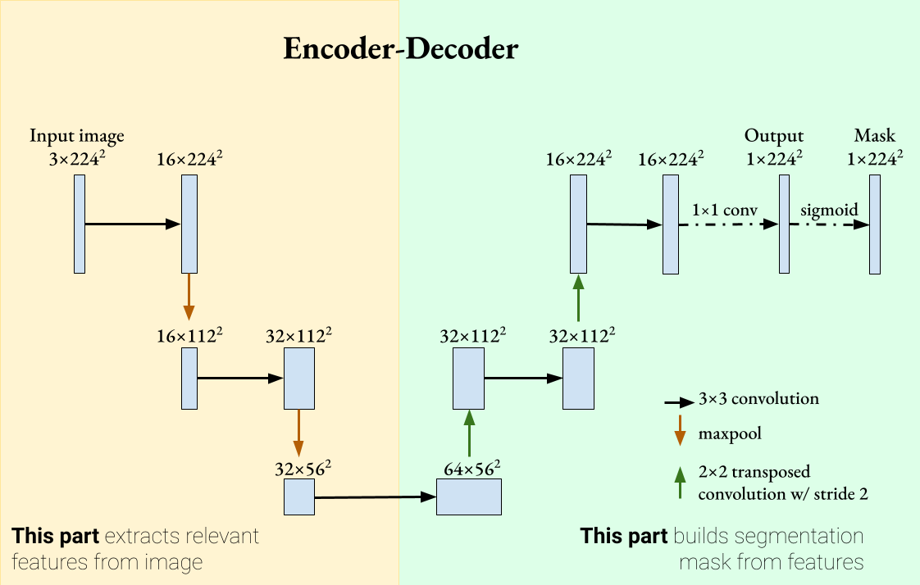
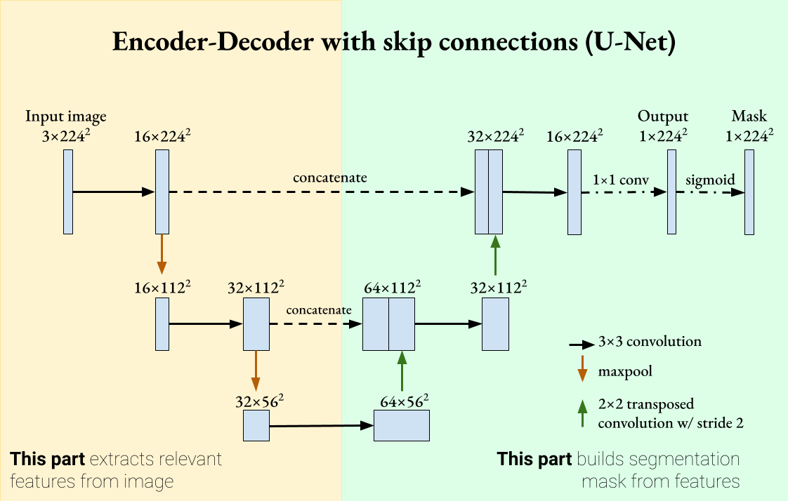
UNets and AutoEncoders
Denoising images is a task that UNets and Autoencoders excel at
UNets share many of the same features as traditional encode-decoder or autoencoder networks
This architecture has become ubiquitous in computer vision
Notes:
https://wikidocs.net/193827
https://towardsdatascience.com/understanding-u-net-61276b10f360

Slide 11
Denoising Images

Slide 12
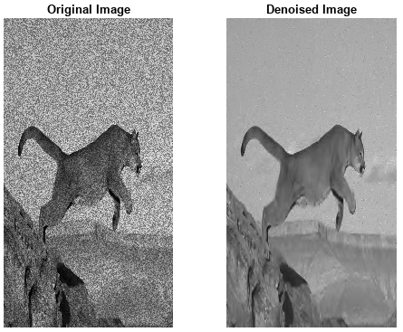
Image Denoising
Denoising is a task in image processing and computer vision.
Aim:
To remove or reduce noise from an image.
Real-world Application:
Noise can be introduced into an image due to various reasons, such as camera sensor limitations, lighting conditions, and compression artifacts.
The goal of denoising is to recover the original image, which is considered to be noise-free, from a noisy observation.
Notes:
https://www.mathworks.com/help/wavelet/ug/wavelet-denoising.html

Slide 13
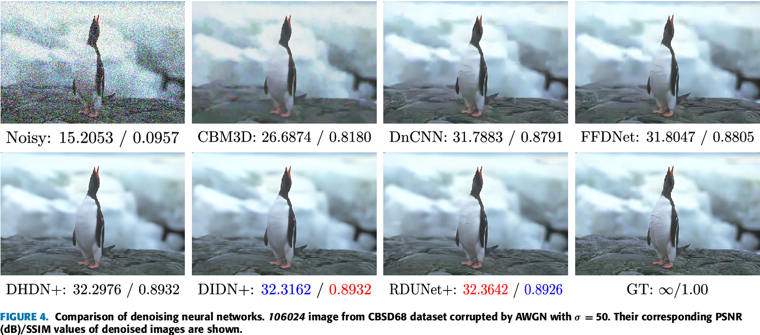
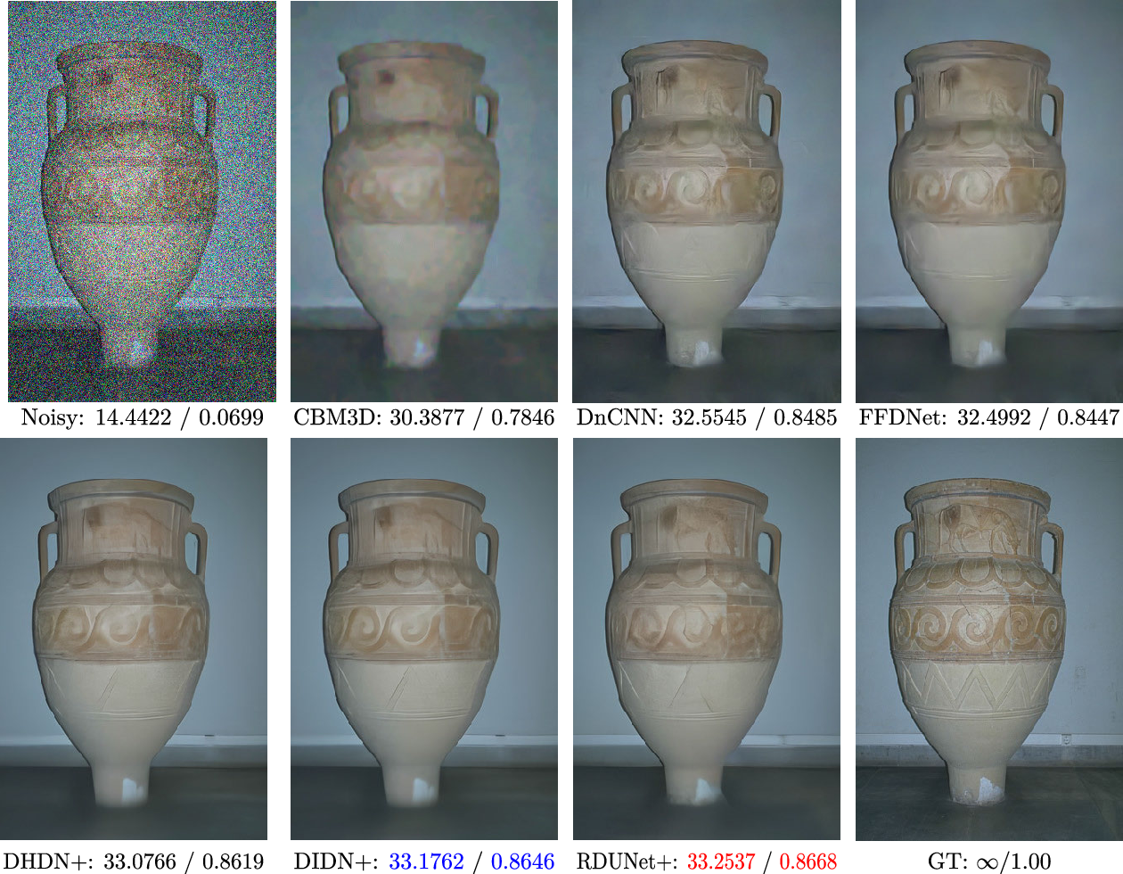
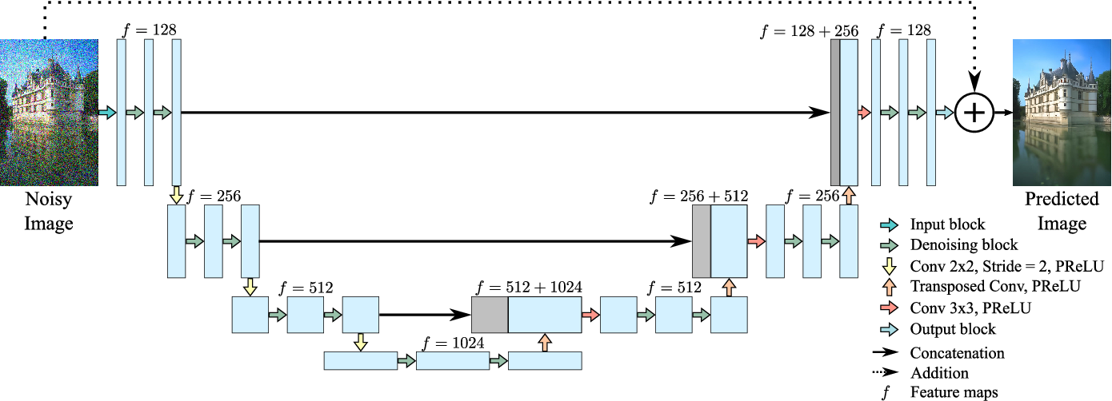
Training a Denoising Model
Training Data:
Input: Gaussian Noise added to clear images
Output: Noise-free images
Metrics:
Typically mean-squared error
Can be more sophisticated such as using loss networks for image perception loss
Adding Noise
Notes:
https://arxiv.org/pdf/1603.08155
https://ieeexplore.ieee.org/document/9360532

Slide 14
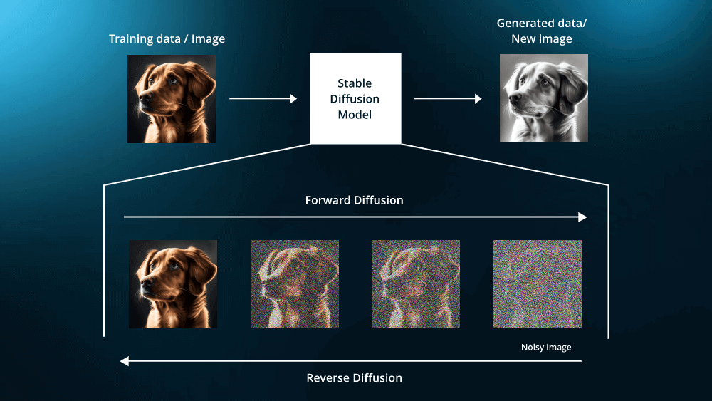
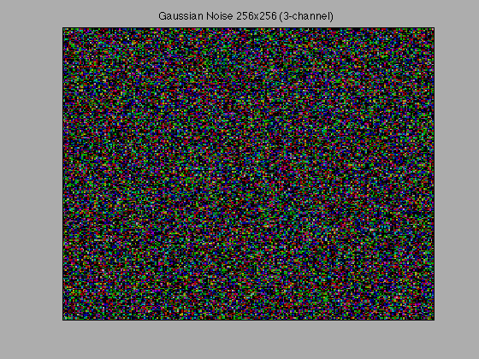
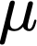

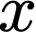
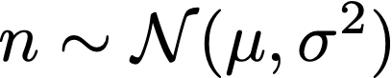
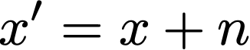
Adding noise to images
Step 1: Define Parameters
Mean, , of the Gaussian noise.
Standard deviation, , of the Gaussian noise.
Step 2: Generate Gaussian Noise
For each pixel value , generate a noise value, , from a Gaussian distribution with mean and standard deviation :
Step 3: Add Noise to Pixel Values:
Add the generated noise value to the original pixel value :
Step 4: Normalize Pixel Values Ensure that the resulting pixel value x' is within the valid range (e.g., [0, 255] for 8-bit images):
+
+
+
Notes:
https://www.leewayhertz.com/how-to-train-a-diffusion-model/

Slide 15
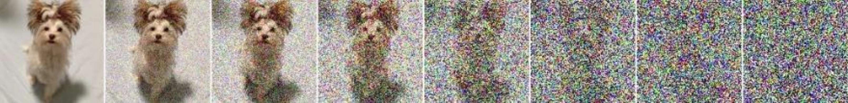
What if there was only noise?
Denoising Models can very successfully remove this gaussian noise from an image
We’ve also seen that with techniques like GANs, we can take a random vector (i.e a vector of noise) and generate new samples
What if we combine these two ideas… A generative architecture based on a denoising model… ?
Generated Samples
Instead of just denoising..
Take random noise and generate samples

Slide 16
Diffusion Models

Slide 17
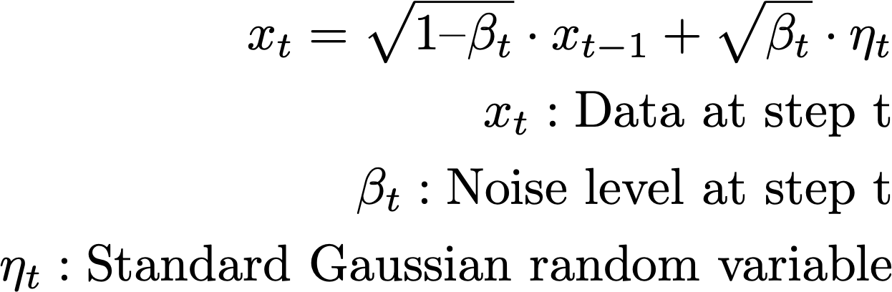
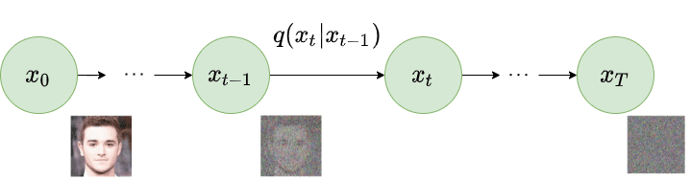
The Forward Diffusion Process – Adding noise to an image
The forward diffusion process is a Markov chain starting from the original data and ending at a noise sample .
At each step t, the data is progressively corrupted by adding Gaussian noise.
Data is progressively corrupted until it becomes pure noise.
By step T, the data is entirely random and independent of .
Forward Diffusion Equation
Note: A Markov chain is a process whereby each state depends only on the previous state.

Slide 18
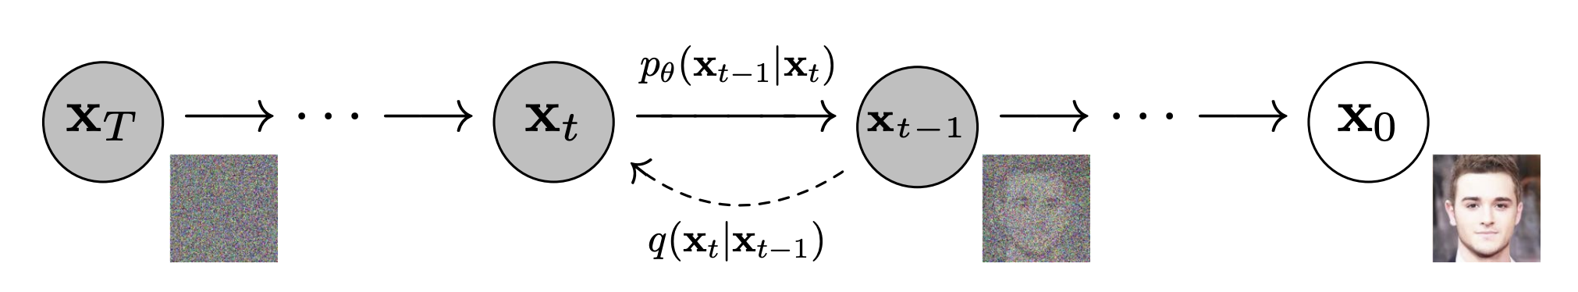
The Reverse Diffusion Process – Removing Noise
The forward process is fairly simple and straight forward:
Take an image and progressively add noise until the structure of the image is gone and only pure noise remains.
But we want to reverse this process. This will allow us to generate images from noise. But how?
This is the reverse process that we need to solve for
This is the forward process (aka the approximate posterior that added noise)

Slide 19
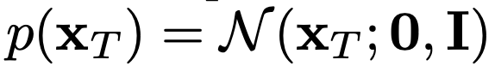
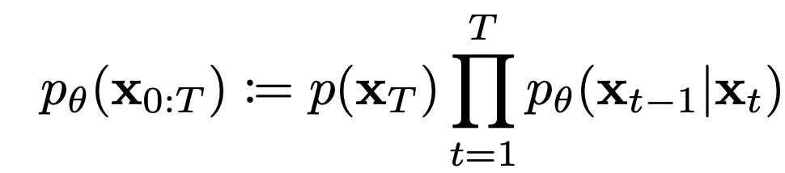
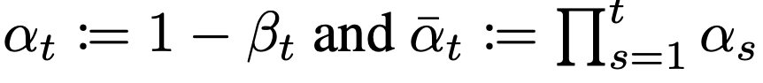
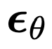
The Reverse Diffusion Process – Learned Gaussian Transitions
We know that the final state of the data is a Gaussian distribution:
We can then define the joint distribution over the whole reverse process, from noise at t=T to the noise-free image at t=0:
To sample an image along this process, we can use:
Where and is the approximated noise at step t

Slide 20
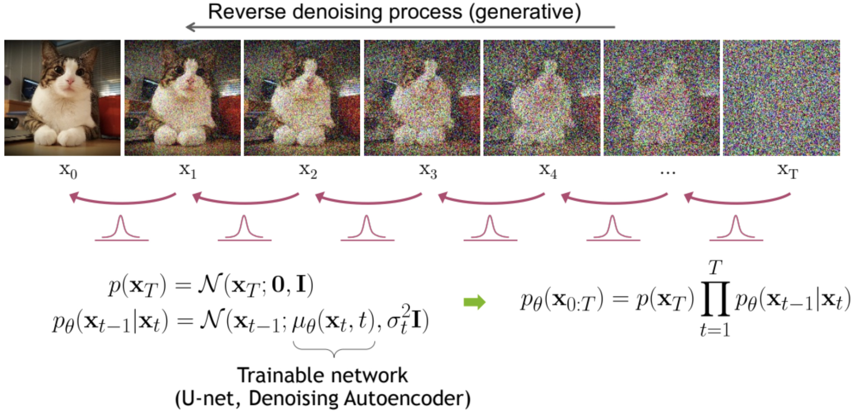
The Denoising Diffusion Probabilistic Model
The DDPM paper, the first diffusion model, utilized a UNet architecture to take as input a noisy image, and was trained to remove the right amount of noise for each step.
In training, the model had access to the exact amount of noise at each step for each training sample. The mean squared error between the noise predicted and the true noise to remove was used as the loss function. Having access to the exact amount of noise is one of the benefits of the closed form of the joint distributions that the forward process affords.
Notes:
https://cvpr2022-tutorial-diffusion-models.github.io/

Slide 21
Pros and Cons of Diffusion Models

Slide 22
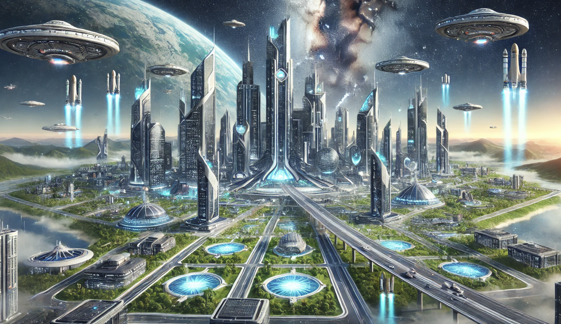
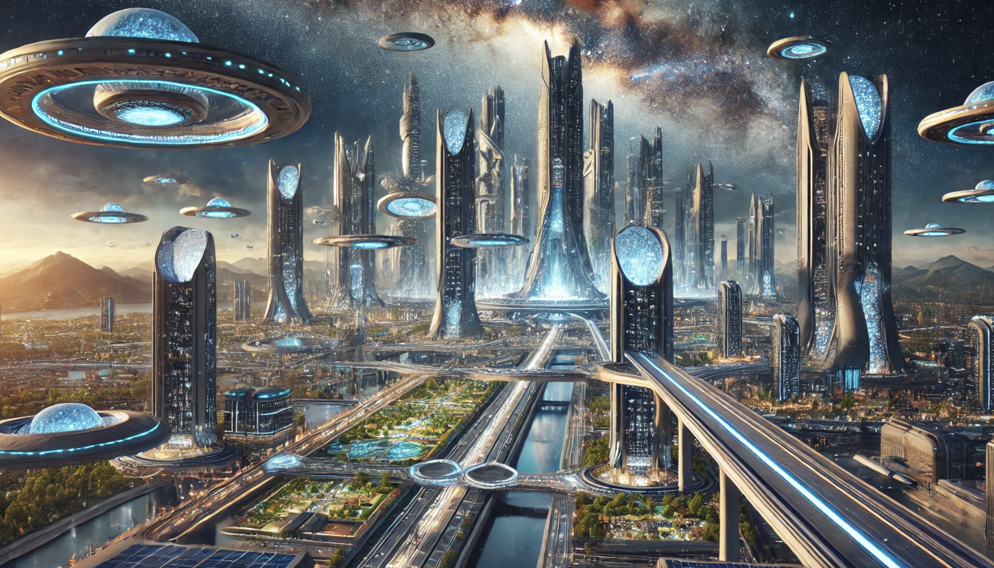
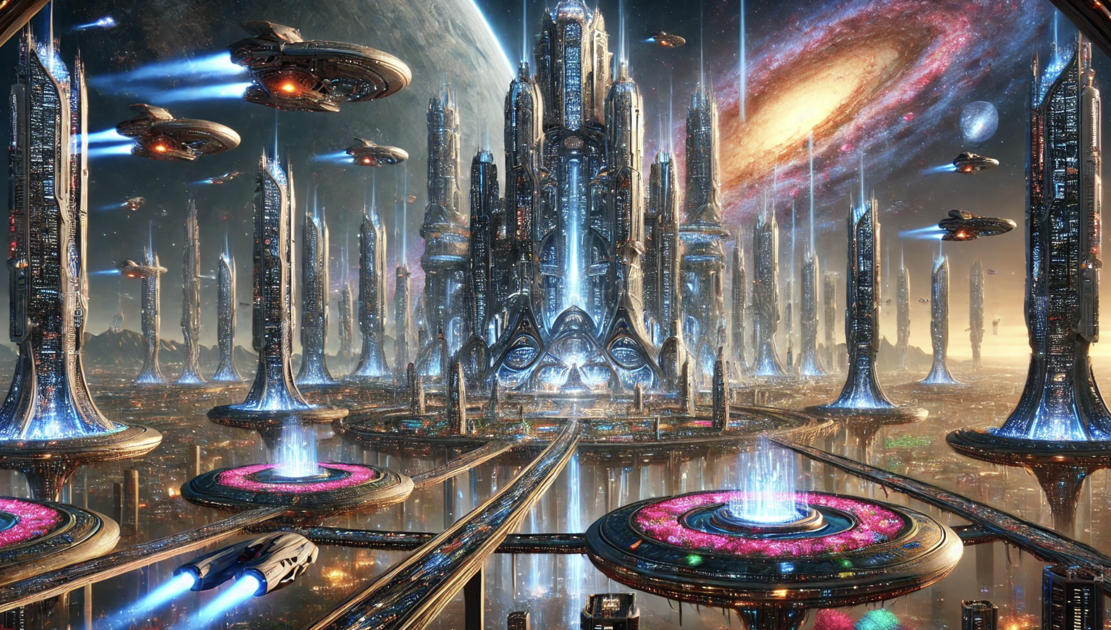
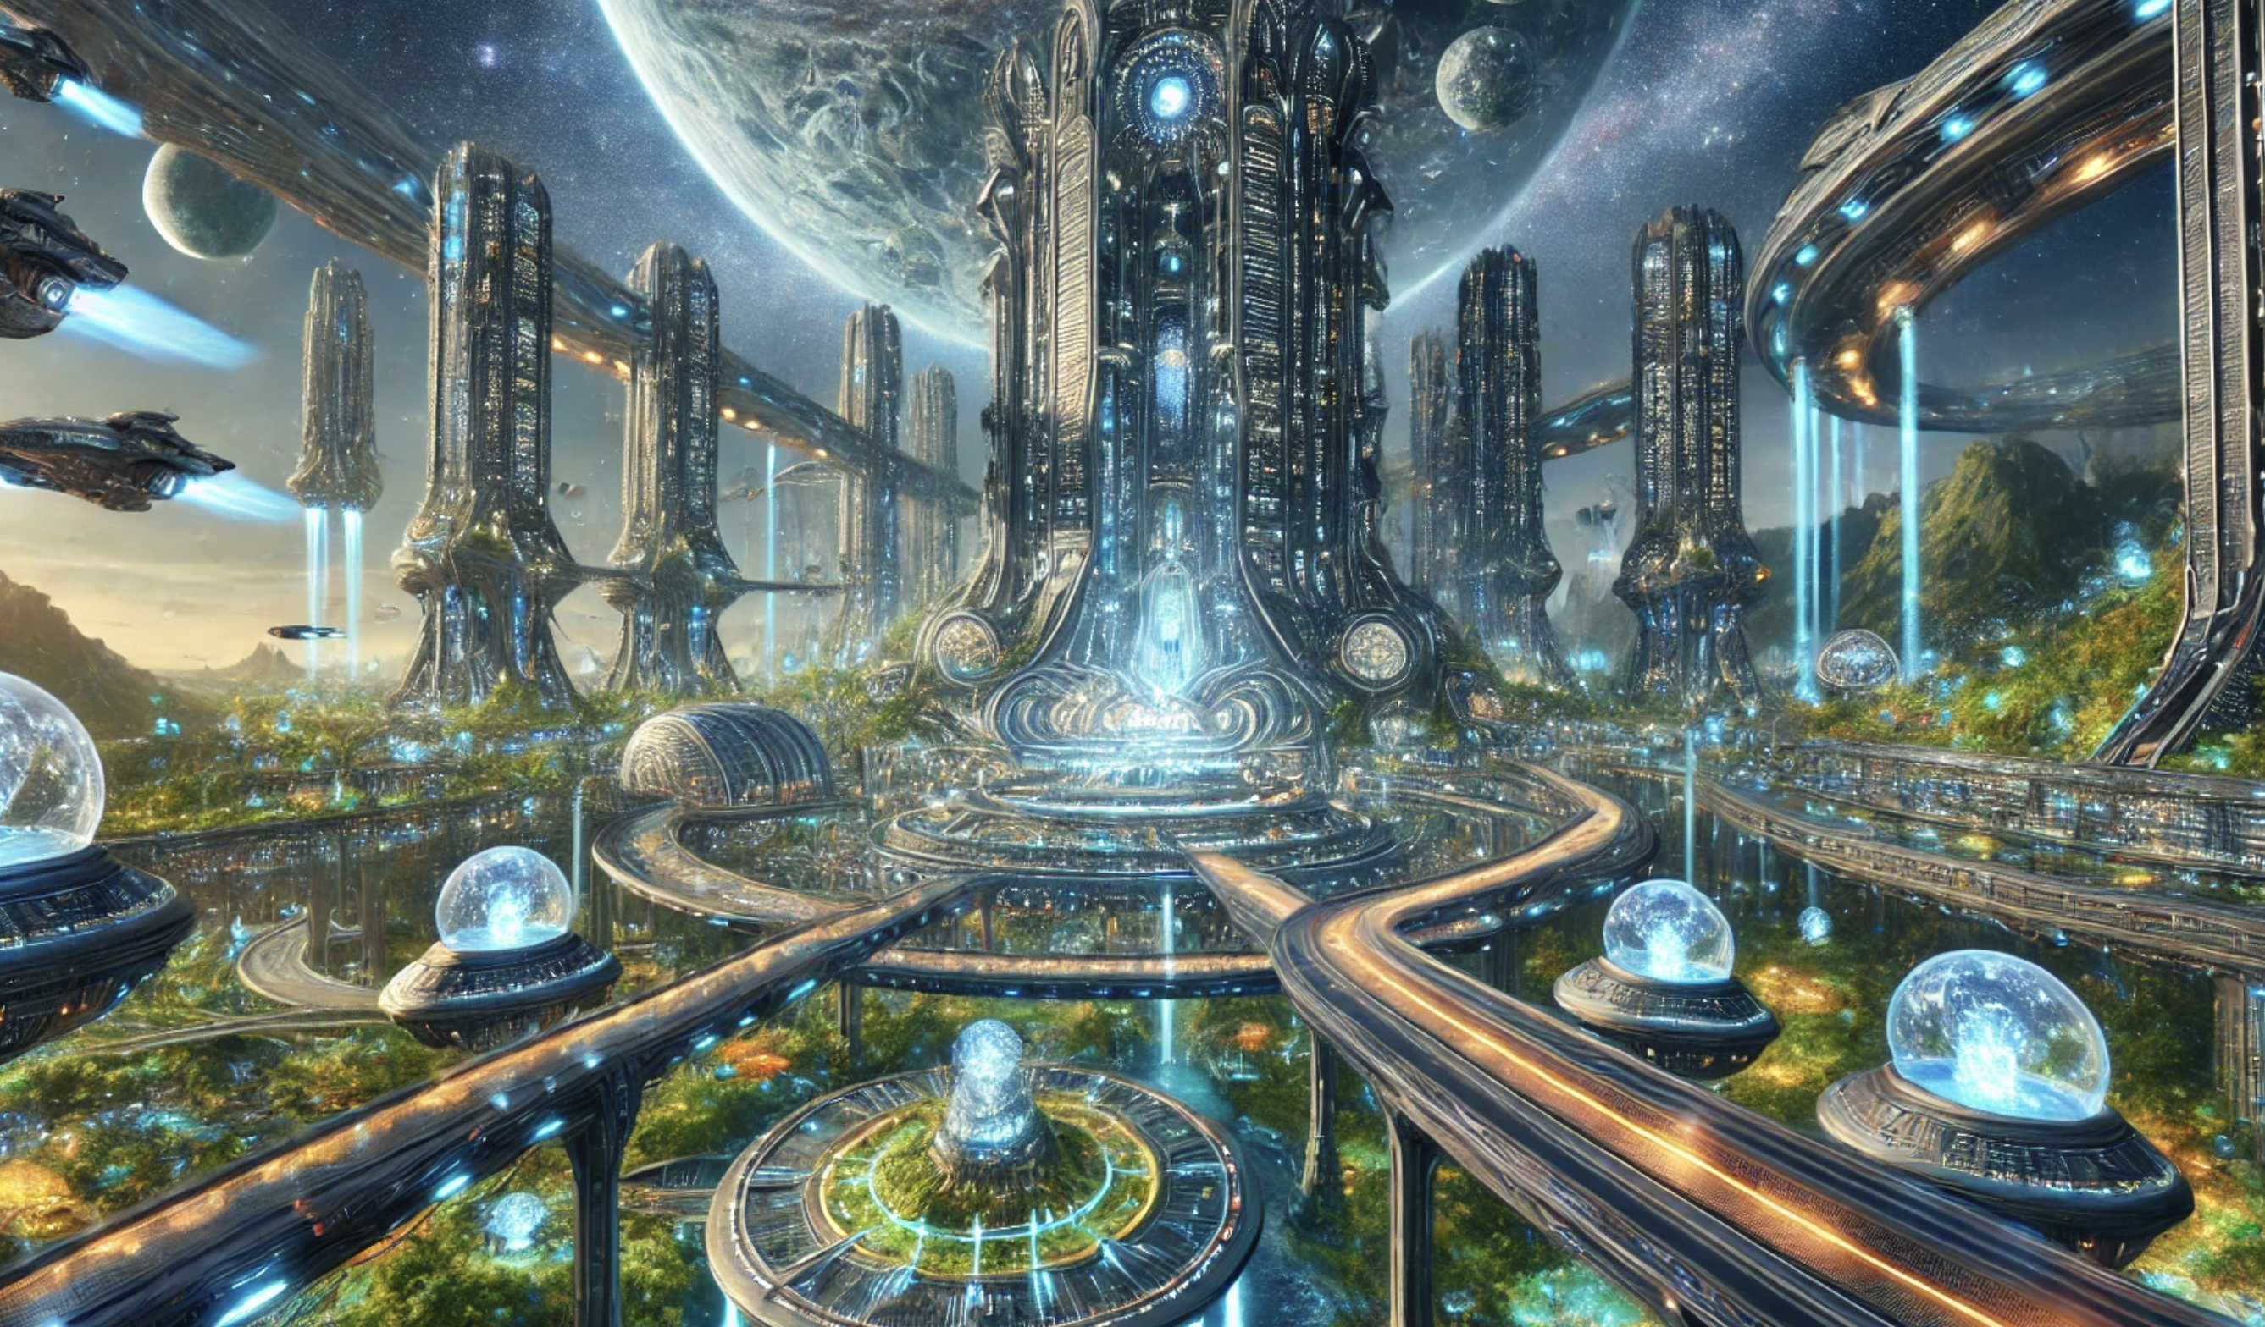
Pros of Diffusion Models
High-Quality Outputs:
Diffusion models can generate high-quality, detailed images, often rivaling or surpassing the output quality of GANs (Generative Adversarial Networks).
Rich Sampling Process:
The iterative nature of the denoising process allows for fine-grained control over the generation, potentially leading to better sample diversity and quality.

Slide 23
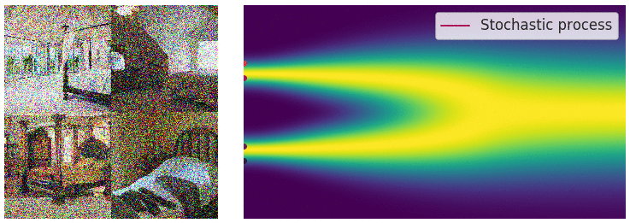
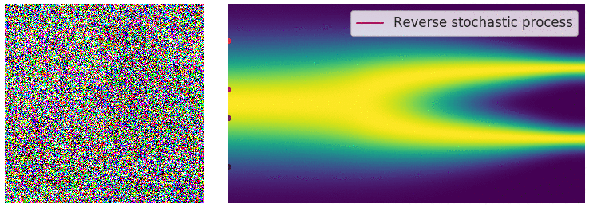
Pros of Diffusion Models
Stable Training
Diffusion models are generally more stable to train compared to GANs, which often suffer from issues like mode collapse and unstable training dynamics.
Theoretical Soundness
The probabilistic framework of diffusion models is well-understood, providing a solid theoretical foundation. This framework allows for explicit control over the generation process.
Notes:
https://yang-song.net/blog/2021/score/

Slide 24
Cons of Diffusion Models
Computationally Intensive
The iterative denoising process requires a large number of forward passes through the network, making it computationally expensive and time-consuming compared to models like GANs that generate images in a single forward pass.
Complex Training Process
The training process can be complex and requires careful tuning of hyperparameters, such as the noise schedule and the loss function, to achieve optimal performance.

Slide 25
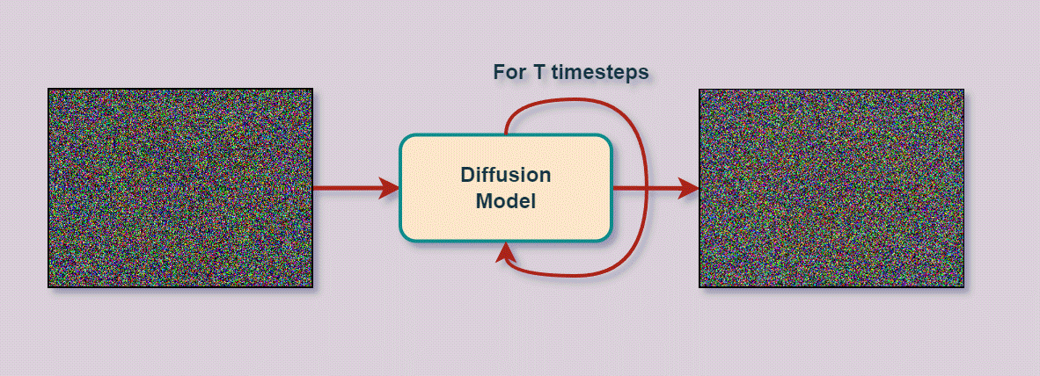
Cons of Diffusion Models
Slow Inference
Due to the iterative nature, generating a single image can take significantly longer compared to other generative models.
Difficulty in Direct Manipulation
Traditional diffusion models do not offer straightforward ways to manipulate specific attributes of the generated data.
Only input is a noise field
Notes:
https://learnopencv.com/image-generation-using-diffusion-models/

Slide 26
Potential Improvements

Slide 27
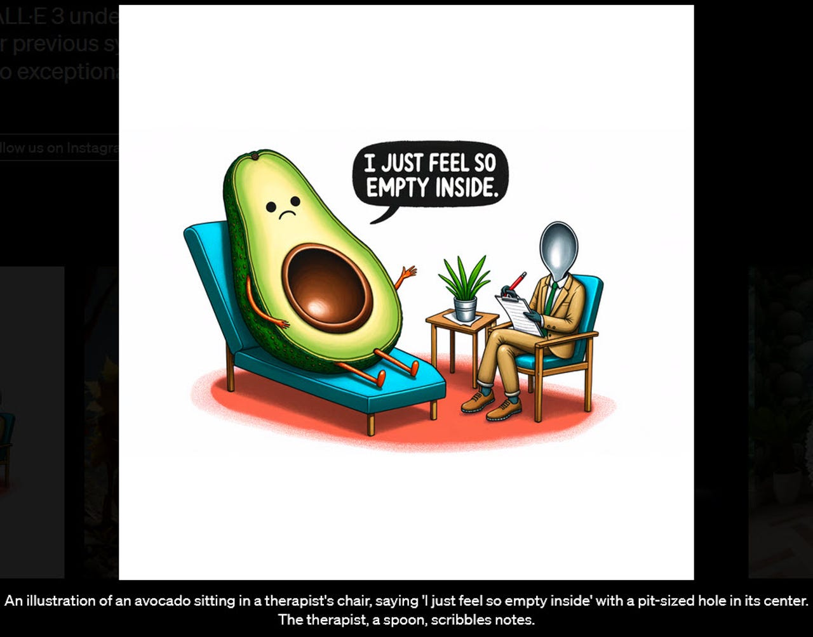
Improvements to traditional Diffusion Methods
In the next lesson, we’ll look at Latent Diffusion Models, like Stable Diffusion
These models:
Incorporate other information to guide the creation of images
Utilize diffusion on the latent space to improve speed and performance
Next time…

Slide 28
Wrap Up
UNets and Diffusion Models
Today we covered new topics in generative image AI
We introduced the UNet architecture
Discussed the problem of denoising images
Discovered the diffusion process to reverse the denoising process to create new images
-----------------------------------------------------------------------------
In the next lesson we will start our discussion on latent diffusion models and how they can overcome some of the traditional diffusion model limitations.

Slide 29
Thank you!

